Slide 1
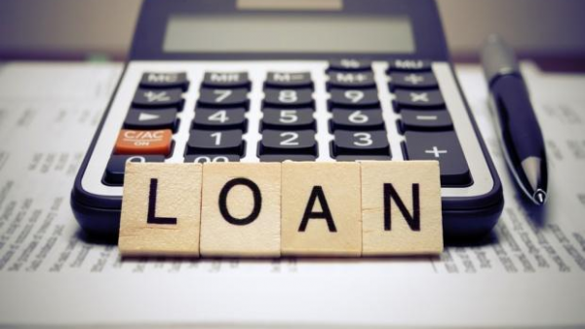
BANK LOAN CASE STUDY
By Sumit Kumar Prajapat
This Photo by Unknown author is licensed under CC BY-SA-NC.

Slide 2
PROJECT DESCRIPTION
Objective
Analyze a loan application dataset for patterns, outliers, imbalances, and correlations related to loan defaults. Build insights for accurate prediction models.
Approach:
Missing Data: Use Python functions for identification (e.g., isnull()) and impute missing values (e.g., mean, median).
Outlier Detection: Utilize Python's statistical functions and visualizations to find outliers in numerical variables.
Data Imbalance: Calculate class frequencies in Python (pandas) and address imbalance through techniques like oversampling/undersampling.
Descriptive & Bivariate Analysis: Perform univariate analysis (describe()) and explore relationships between variables (correlation).
Correlation Analysis: Calculate variable-target correlations with Python visualize using heatmaps.

Slide 3
APPROACH
I began the project by analyzing a application dataset to understand its structure and identify any missing data. I used Python and its pandas library to handle missing values, employing functions like isnull() to detect missing entries.
To identify potential outliers that could impact the analysis, I utilized Python's statistical functions and visualizations, such as box plots and scatter plots.
Next, I addressed data imbalance issues in the dataset using Python's pandas library. I calculated target variable with value_counts() and considered techniques to balance the data.
For gaining insights into the dataset, I conducted univariate, segmented univariate, and bivariate analyses using Python's describe() function for descriptive statistics, for segmented analysis, and bivariate analysis.
To explore the relationships between variables and the target variable, I calculated correlation coefficients using Python's corr() function and visualized the correlations with heatmaps.
Throughout the project, I leveraged various Python libraries, including pandas and matplotlib, to efficiently handle, analyze, and visualize the data

Slide 4
TECH STACK USED
Tech-Stack Used:
Python: Utilized for data analysis and manipulation.
PyCharm : Facilitated efficient coding and debugging.
Libraries:
pandas: Employed for data handling and analysis.
Seaborn : Used for creating visualizations, including box plots, scatter plots, and heatmaps.
matplotlib : Used for additional data visualization capabilities and customization.

Slide 5
INSIGHT
Addressed missing data using Python, ensuring dataset completeness.
Identified outliers in numerical variables, understanding extreme data points' impact.
Balanced data distribution, improving prediction model accuracy.
Discovered patterns and trends through descriptive and bivariate analysis.
Uncovered significant correlations, highlighting loan default indicators.
Built accurate prediction models for risk assessment and informed decision-making.
Enhanced risk management and loan approval procedures for financial institutions.

Slide 6
RESULT
Analyzed the loan application dataset, gaining insights into loan default factors.
Utilized Python and its libraries for proficient data analysis.
Handled missing data, identified outliers, and addressed data imbalances.
Built accurate loan default prediction models, improving risk assessment.
Emphasized the importance of data-driven decision-making in financial institutions.
Acquired transferable skills applicable to diverse datasets and real-world scenarios.
A transformative and enlightening journey in data analysis and financial risk management.

Slide 7
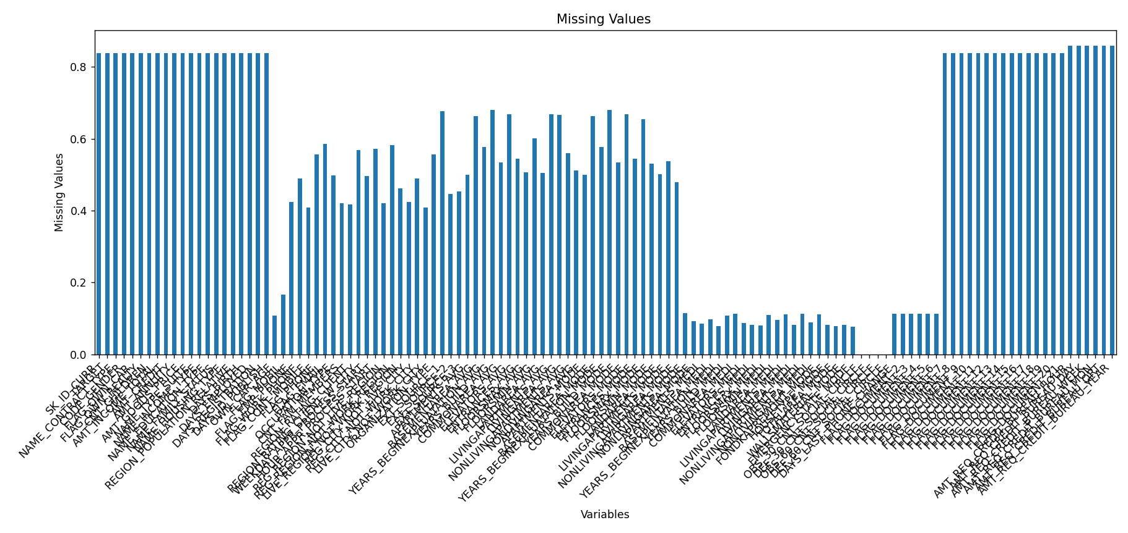
TASK 1 MISSING DATA

Slide 8
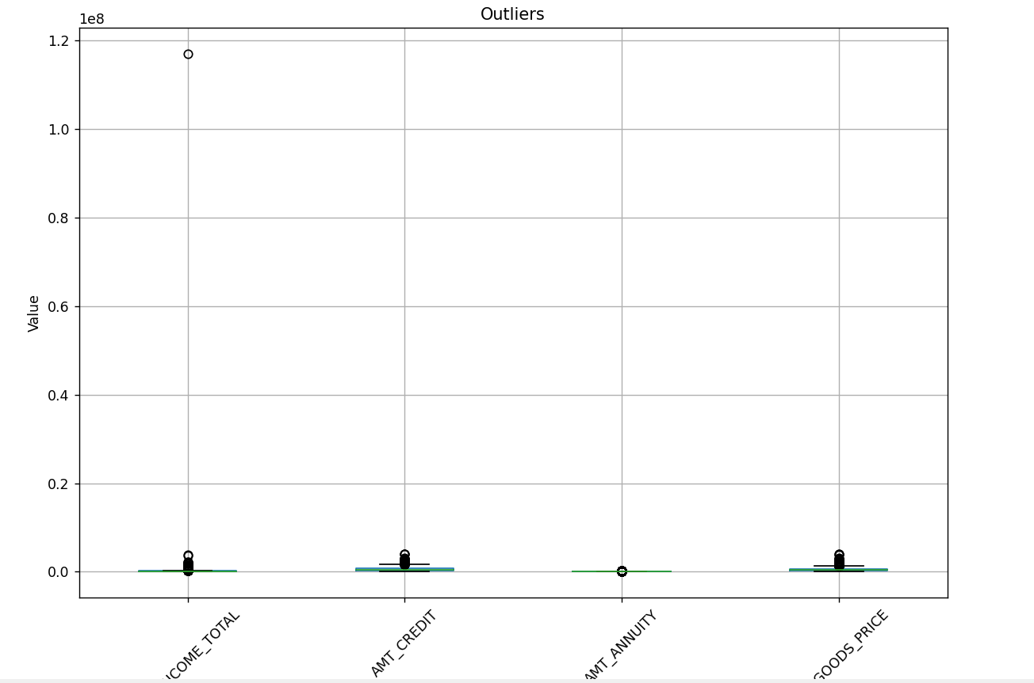
TASK 2 OUTLIERS

Slide 9
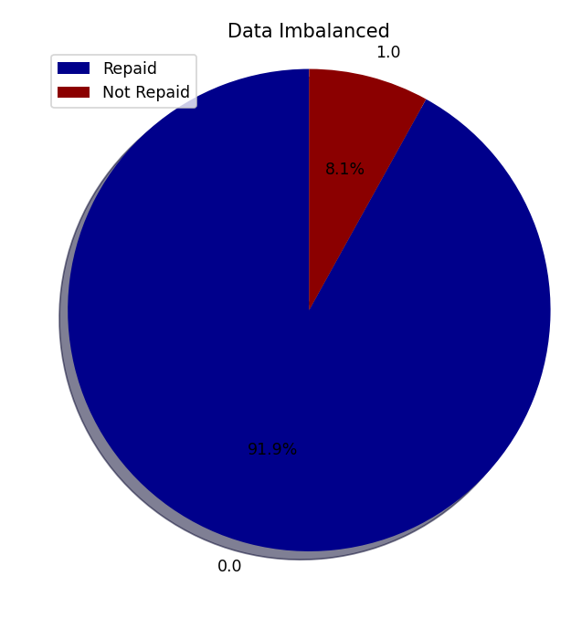
TASK 3 DATA IMBALANCED

Slide 10
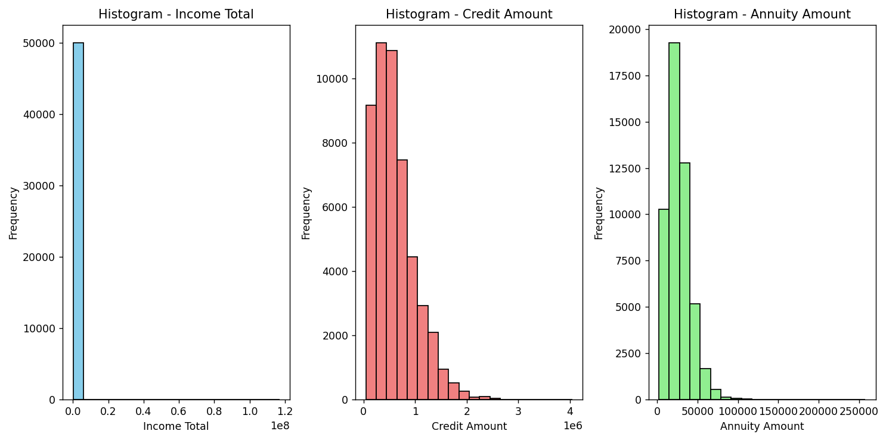
TASK 4: UNIVARIATE ANALYSIS

Slide 11
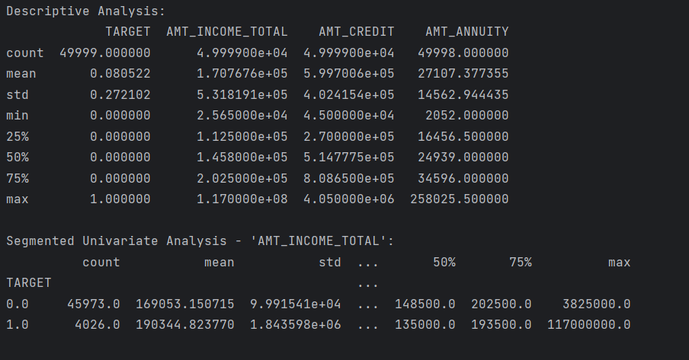
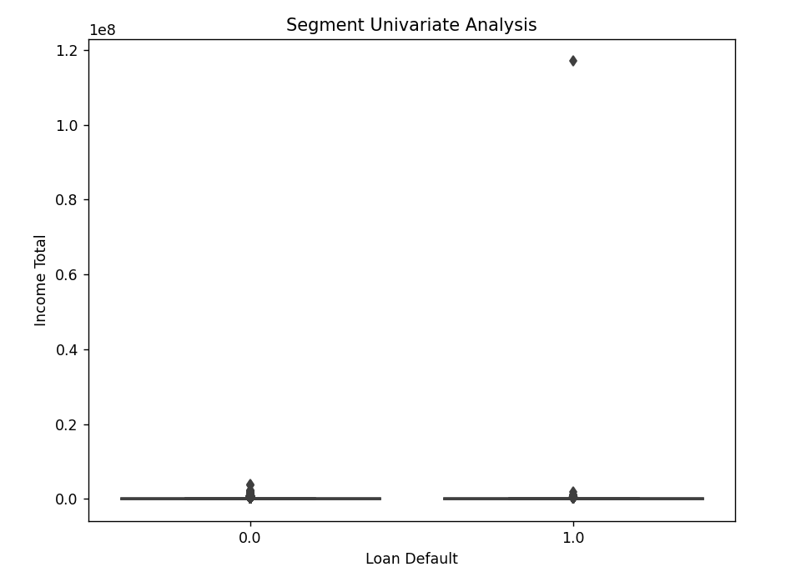
TASK 4: SEGMENT UNIVARIATE ANALYSIS

Slide 12
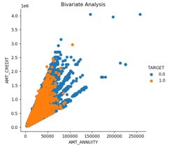
TASK 4: BIVARIATE ANALYSIS

Slide 13
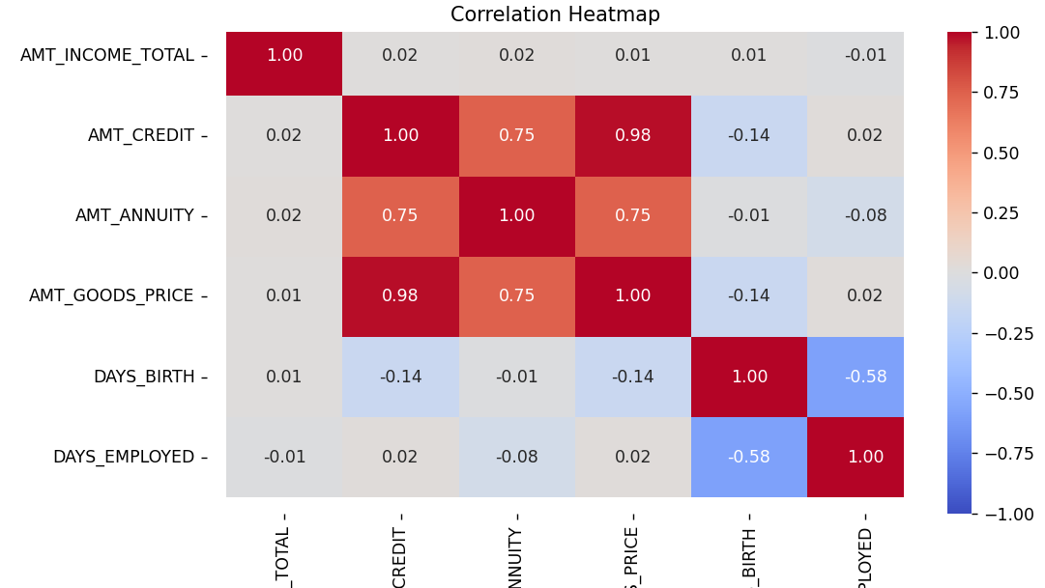
TASK 5: CORELATION FOR PAYMENT DIFFICULTIES

Slide 14
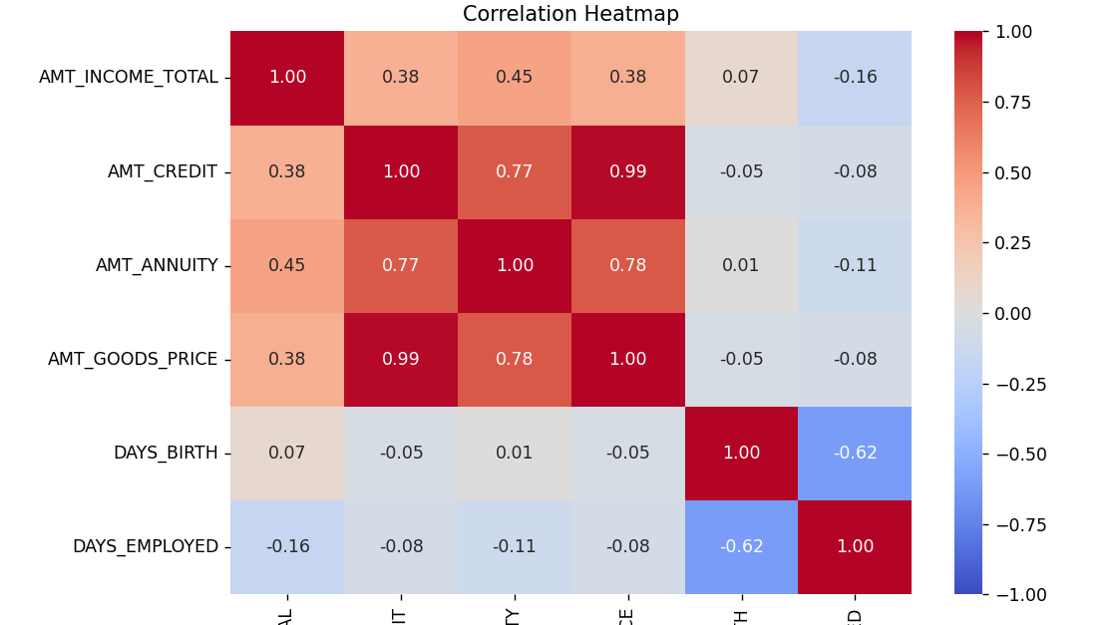
TASK 5: CORELATION FOR NO PAYMENT DIFFICULTIES

Slide 15
THANK YOU
By Sumit K Prajapat
Drive Link: Data
Video Explanation: First Video
second vedio
Third Vedio
Fourth video

